Slide 1

AST

Slide 2

Telecom Customer Churn Analysis
AST

Slide 3

Supervised By
Kareem El-Demedash
AST

Slide 4
Challengers Group
Doaa M.Fahmy Mona Khaled Nourhan Ibrahim
Nada Mohamed Ayat Mohamed Marina Atef

Slide 5
Customer Churn Analysis
Introduction
Dashboard Presentation
Conclusion
Offer Performance
Technical Support Subscriptions
Internet Service Usage
Geographic Distribution
Contract Type Preferences
Churn Rates

Slide 6

Introduction
Our project aims to investigate the factors contributing to customer churn in a telecom company and provide insights for improving customer retention. Our analysis explores the reasons for churn, geographical patterns, contract preferences, the impact of offers and internet services, and the role of premium technical support.

Slide 7


Customer churn rates refers to more than a quarter of total customers

Slide 8
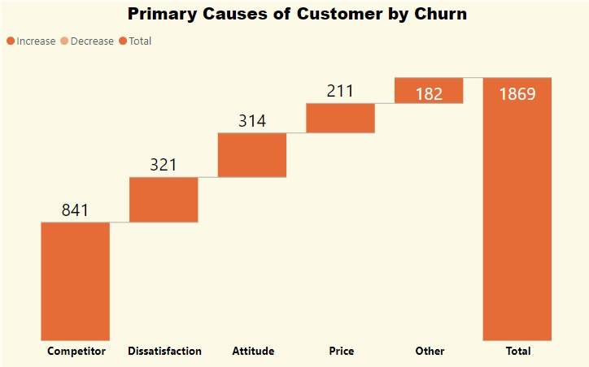
The strength of the competing companies is the fist worker of churn,
As well as the dissatisfacation about services ,in addition to the weakness of employee performance

Slide 9
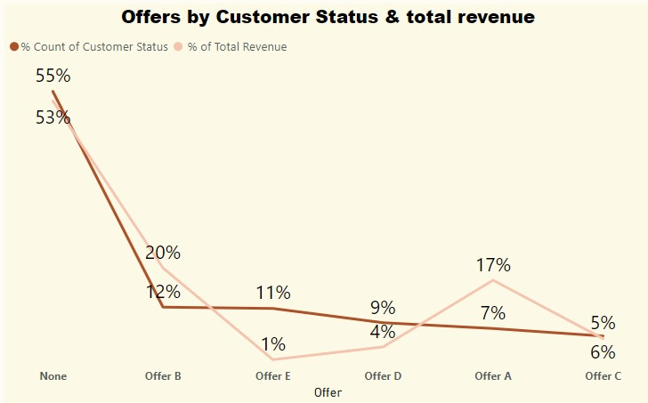
More than 50% of customers don’t participate by offers that’s indicates the weakness of offers

Slide 10
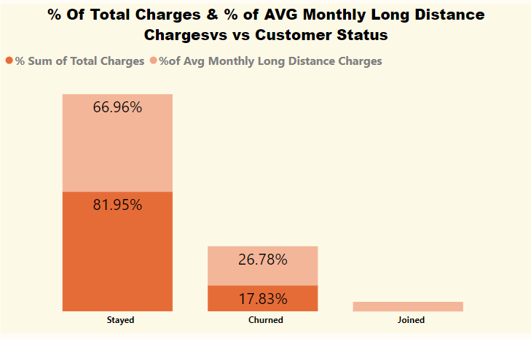
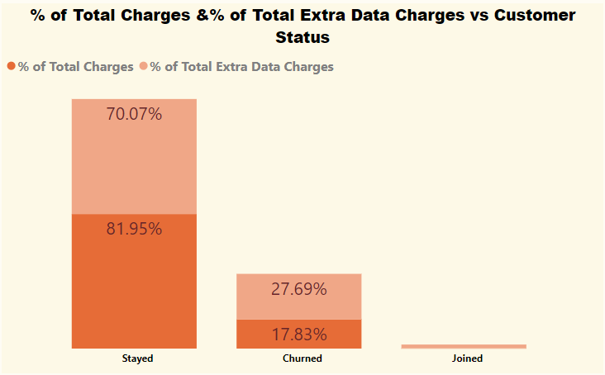
Customer churn pays for additional services more than
what he pays for total services

Slide 11
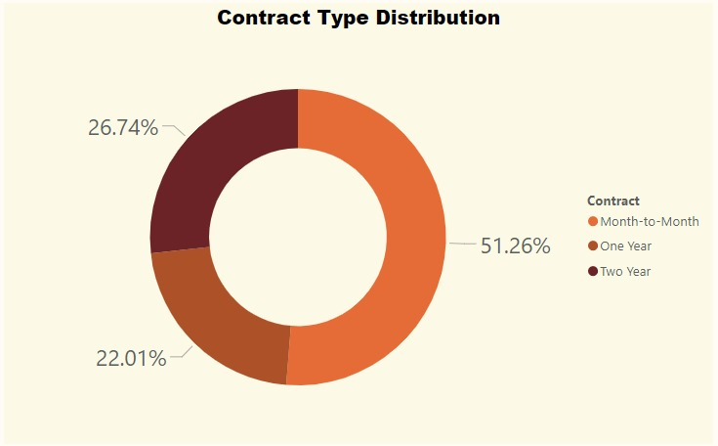
Most of customers, especially the churn customers are subscribed to the monthly payment system which confirms that this system is not suitable for the needs of the customers

Slide 12

Competitive offers and customer dissatisfaction are primary churn drivers.Geographic and service-related factors influence churn. Addressing these issues can improve retention and reduce churn rates.
Conclusion

Slide 13
AST
Thank you

